Slide 1
Ch – 3 Developing an SEO – Friendly Website

Slide 2
Content :
Making site accessible to Search Engine
Creating an optimal Information Architecture
Root Domains , Subdomains , & Microsites
Optimization of Domain Names / URLs
Keyword Targeting
Content Optimization
Duplicate Content Issues Controlling content with cookies and session IDs

Slide 3
Content Delivery and Search Spider Control
Redirect , CMS Issues
Optimizing Flash
Best practices for Multilanguage / country Targeting

Slide 4
Making site accessible to Search Engine :
The first step in the SEO design process is to ensure that your site can be found and crawled by the search engines.
This is not as simple as it sounds, as there are many popular web design and implementation constructs that the crawlers may not understand.

Slide 5
Indexable Content : To rank well in the search engines, your site’s content—that is, the material available to visitors of your site—should be in HTML text form.
Images , Flash files , java applets ,and Other nontext content is , for thee most part , virtually invisible to search engine spiders advance in crawling technology…
Spiderable Link Structures : search engines use links on web pages to help them discover other web pages and websites.

Slide 6
For this reason, we strongly recommend taking the time to build an internal linking structure that spiders can crawl easily.
Many sites make the critical mistake of hiding or obfuscating their navigation in ways that limit spider accessibility, thus impacting their ability to get pages listed in the search engines’ indexes.

Slide 7
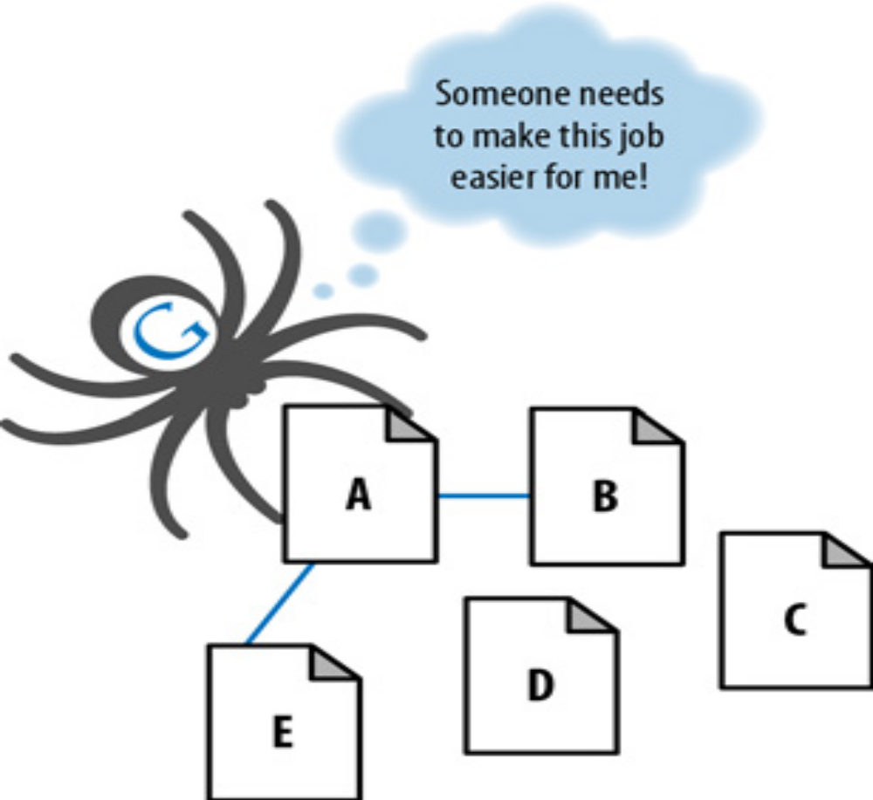

Slide 8
Creating an optimal Information Architecture :
Making your site friendly to search engine crawlers also requires that you put some thought into your site information architecture.
A well-designed architecture can bring many benefits for both users and search engines.
Shows what it looks like when you apply this logic to the popular website , Craigslist.org.

Slide 9
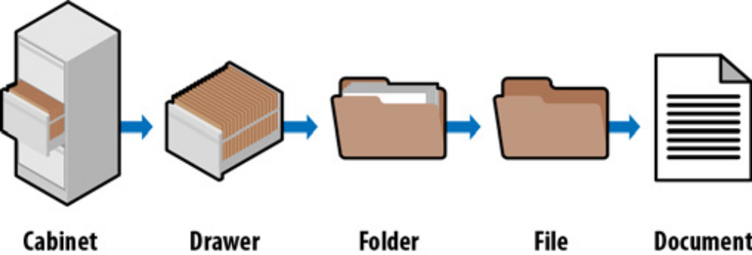

Slide 10
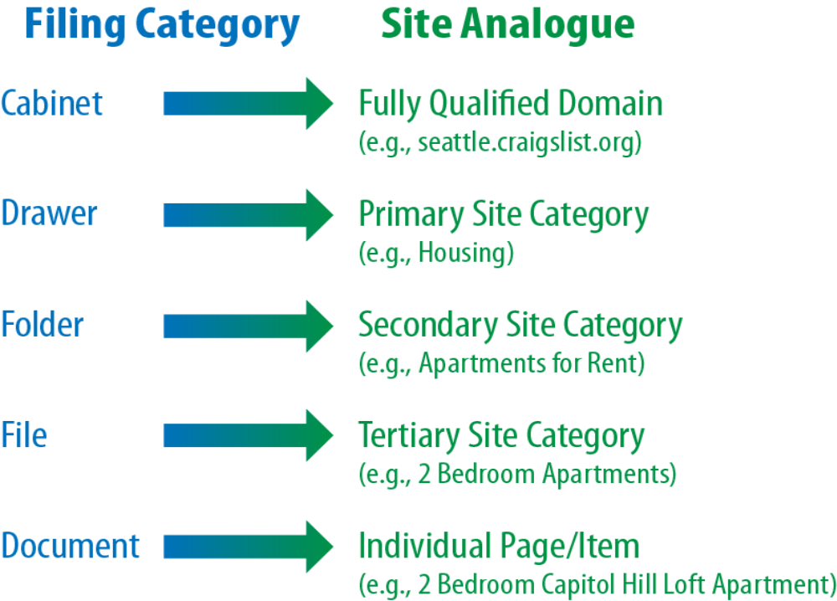

Slide 11
Root Domains , Subdomains , & Microsites :
Among the common questions that arise when structuring a website (or restructuring one) are whether to host content on a new domain, when to use subfolders, and when to employ microsites.

Slide 12
When to Use a Subdomain : If your marketing team decides to promote a URL that is completely unique in content or purpose and would like to use a catchy subdomain to do it, using a subdomain can be practical.
Maps.google.com is an example of where the marketing considerations make a subdomain an acceptable choice.
One good reason to use a subdomain is in a situation where doing so can
look more authoritative to users, as a result of creating separation from the main domain.

Slide 13
Microsites : There is a lot of debate about microsites, and although we generally recommend that you do not saddle yourself with the hassle of dealing with multiple sites and their SEO risks and disadvantages, it is important to understand the arguments, even if there are only a few, in favor of doing so.

Slide 14
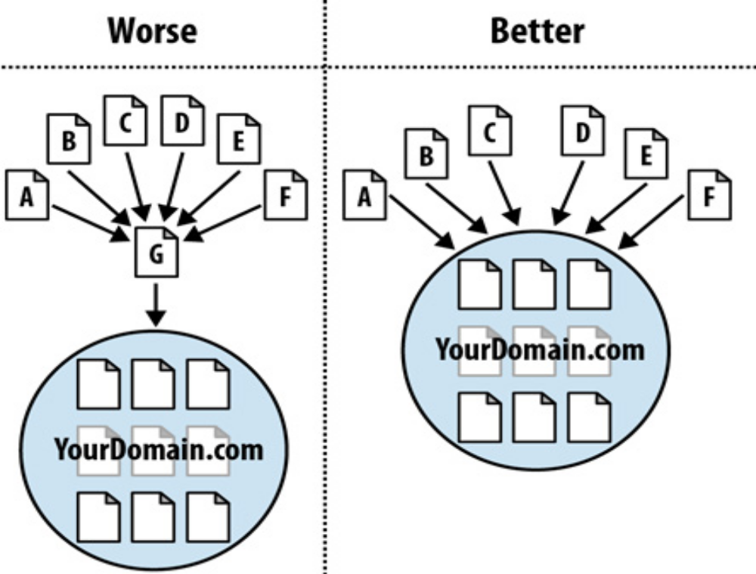

Slide 15
Optimization of Domain Names / URLs :
Two of the most basic parts of any website are the domain name and the URLs for the pages of the website.
This section will explore guidelines for optimizing these important elements.
Optimizing Domains : When a new site is being conceived or designed, one of the critical items to consider is the naming of the domain, whether it is for a new blog, a company launch, or even just a friend’s website….

Slide 16
Picking the Right URLs : Search engines place some weight on keywords in your URLs.
Be careful, however, as the search engines can interpret long URLs with numerous hyphens in them (e.g., Buy-this- awesome-product-now. html) as a spam signal.
What follows are some guidelines for selecting optimal URLs for the pages of your site (s).

Slide 17
Keyword Targeting :
The search engines face a tough task: based on a few words in a query (or sometimes only one), they must return a list of relevant results, order them by measures of importance, and hope that the searcher finds what she is seeking.
This practice has long been a critical part of search engine optimization, and although other metrics (such as links) have a great deal of value in the search rankings, keyword usage is still at the core of targeting search traffic…..

Slide 18
The first step in the keyword targeting process is uncovering popular terms and phrases that searchers regularly use to find the content, products, or services your site offers.
Now, keyword relevance is much more aligned with the usability of a page from a human perspective.
keyword usage includes creating titles, headlines, and content designed to appeal to searchers in the results , as well as building relevance for search engines to improve your rankings.

Slide 19
Content Optimization :
Content optimization relates to how the presentation and architecture of the text, image, and multimedia content on a page can be optimized for search engines.
Having the right formatting or display won’t boost your rankings directly, but through it, you’re more likely to earn links, get clicks, and eventually benefit in search rankings.

Slide 20
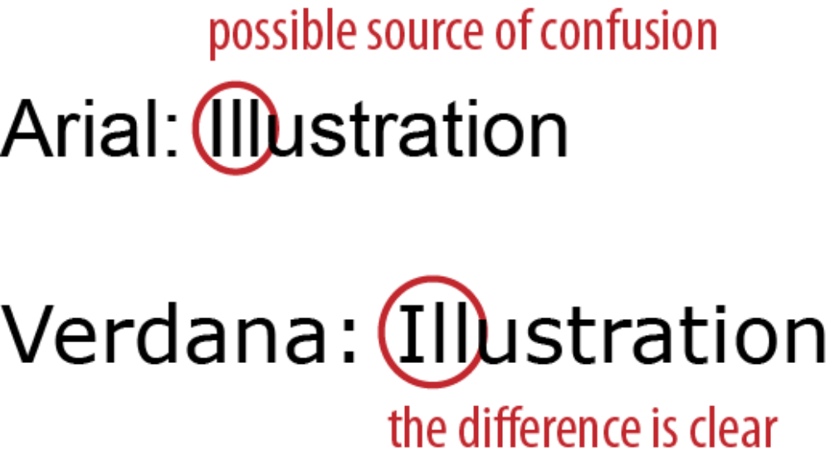

Slide 21
Duplicate Content Issues :
Duplicate content can result from many causes, including licensing of content to or from your site, site architecture flaws due to non-SEO-friendly CMS….
Thus, today we’re faced with a world of “duplicate content issues” and “duplicate content penalties.”
Here are some definitions that are useful for this discussion:

Slide 22
Unique content
Duplicate content filter
Duplicate content penalty
Duplicate content filter

Slide 23
Unique content
Duplicate content filter
Duplicate content penalty
Duplicate content filter

Slide 24
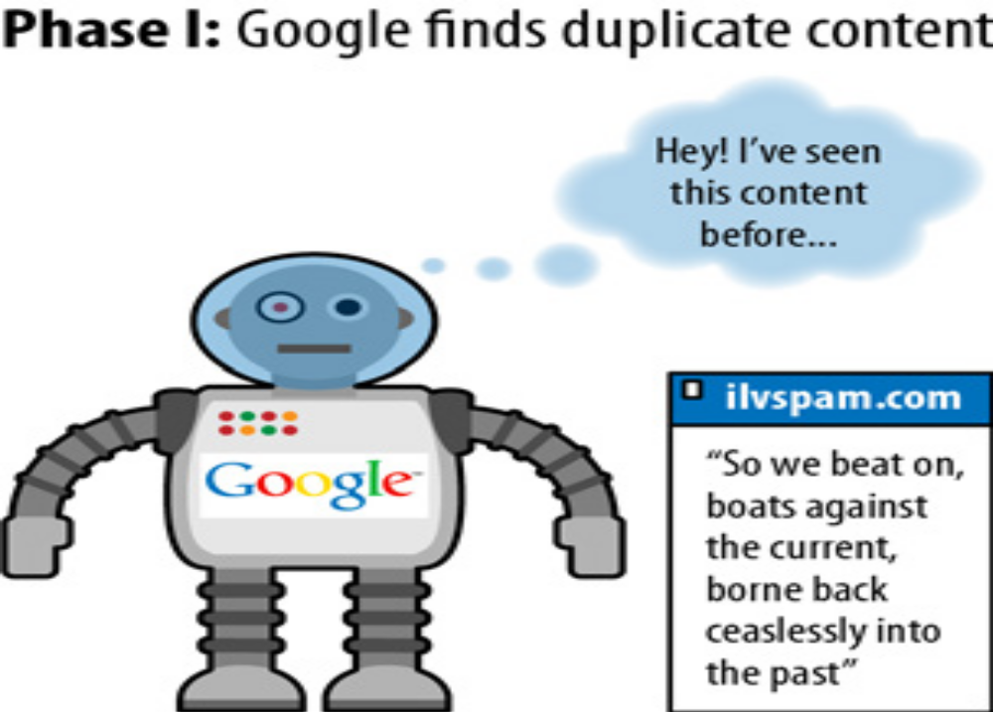

Slide 25
Controlling content with cookies and session IDs :
What’s a Cookie? :- A cookie is a small text file that websites can leave on a visitor’s hard disk, helping them to track that person over time.
Cookie data typically contains a short set of information regarding when you last accessed a site, an ID number, and, potentially, information about your visit….

Slide 26
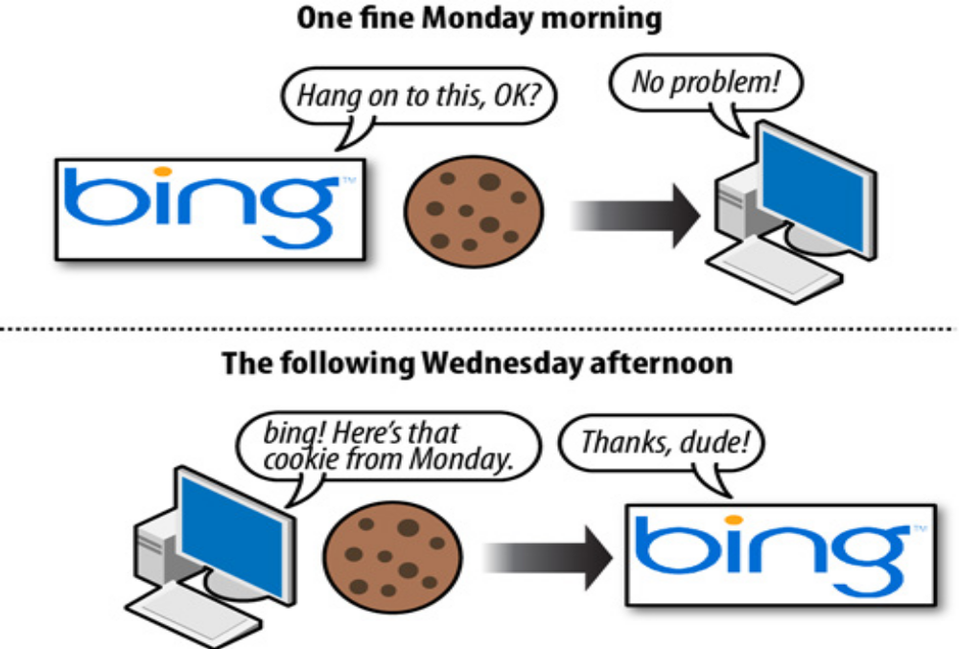
Figure: Using cookies to store data

Slide 27
What Are Session IDs? :- Session IDs are virtually identical to cookies in functionality, with one big difference…
when you close your browser (or restart), session ID information is (usually) no longer stored on your hard drive. Figure 6 illustrates…..
The website you were interacting with may remember your data or actions, but it cannot retrieve session IDs from your machine that don’t persist..
In essence, session IDs are like temporary cookies…

Slide 28
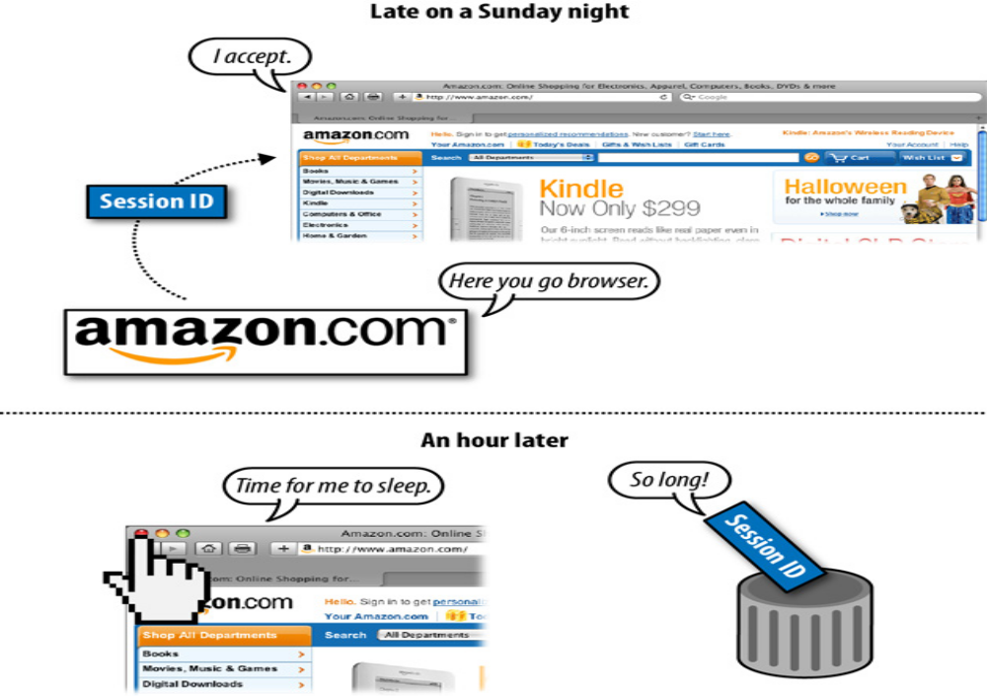

Slide 29
Content Delivery and Search Spider Control :
On occasion, it can be valuable to show search engines one version of content and show humans a different version.
This is technically called “cloaking,” and the search engines’ guidelines have near-universal policies restricting this behavior.
In practice, many websites, large and small, appear to use some forms of cloaking without being penalized by the search engines.

Slide 30
However, use great care if you implement these techniques, and know the risks that you are taking.
Cloaking and Segmenting Content Delivery :- Before we discuss the risks and potential benefits of cloaking-based practices, take a look at Figure , which shows an illustration of how cloaking works.

Slide 31
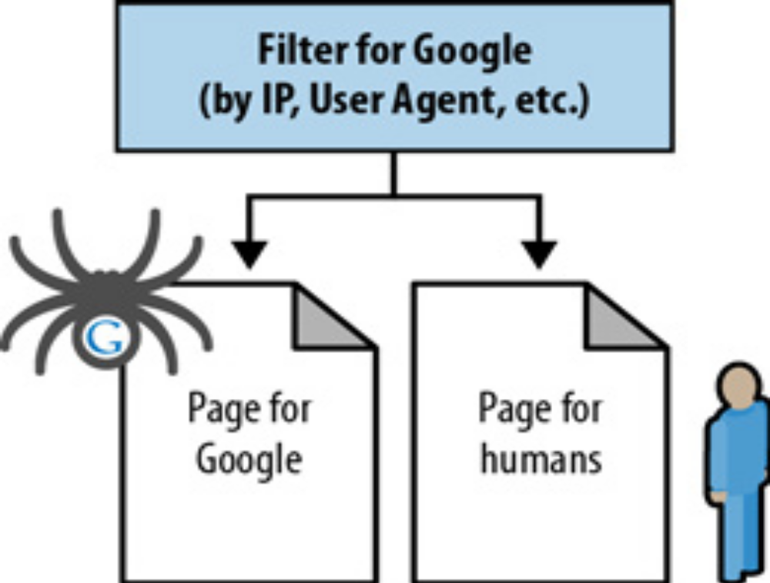
How cloaking works

Slide 32
Redirect :
A redirect is used to indicate when content has moved from one location to another.
For example, suppose you have some content at http://www.yourdomain.com/old.html , and you decide to restructure your site.
As a result of this restructuring, your content may move to http://www.yourdomain.com/critical-keyword.html .

Slide 33
Once a redirect is implemented, users who go to the old versions of your pages will be sent to the new versions of those pages.
Without the redirect, the user would get a Page Not Found (404) error.
With the redirect, the web server tells the incoming user agent (whether a browser or a spider) to instead fetch the requested content from the new URL.

Slide 34
Content Management System (CMS) Issues :
When looking to publish a new site, many publishers may wonder whether they need to use a CMS, and, if so, how to ensure that it is SEO-friendly.
It is essential to determine whether a CMS is necessary before embarking on a web development project.
You can use the flowchart in Figure to help guide you through the process.

Slide 35
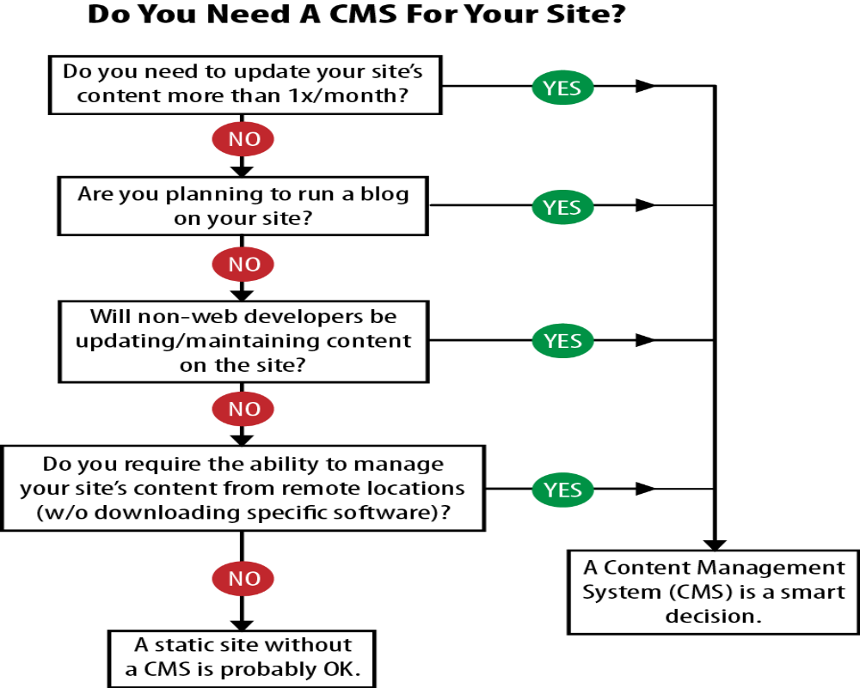

Slide 36
Due to the inexpensiveness of customizable, free platforms such as Drupal, Joomla, WordPress, and Mambo, it is increasingly rare for a publisher to develop a static site, even when a CMS isn’t required.

Slide 37
Optimizing Flash :
Flash is popular on the Web, but it presents challenges to the search engines in terms of indexing the related content.
This creates a gap between the user experience with a site and what the search engines can find on that site.
It used to be that search engines did not index Flash content at all.
In June 2008, Google announced that it was offering improved indexing of this content( http://googlewebmastercentral.blogspot.com/2008/06/improved-flash-indexing.html )

Slide 38
This announcement indicates that Google can index text content and find and follow links within Flash files.
However, Google still cannot
tell what is contained in images within a Flash file…
Different content is not on different URLs
The breakdown of text is not clean
Flash gets embedded
Flash doesn’t earn external links like HTML

Slide 39
Best practices for Multilanguage / country Targeting :
Targeting a Specific Country : Starting with the basics of international targeting, it is important to let the search engines know where your business is based in as many ways as possible.
These might include :-
• Hosting your site locally, not abroad
• Including the physical local address in plain text on every page of your site
• Setting Google Webmaster Central geotargeting to your country of interest

Slide 40
• Verifying your address with Google Maps
• Getting links from in-country websites
• Using the local language on the website

